Slide 1
Self-Driving Car
Predicting Steering Wheel Angle
Cristian Daniel Rodríguez Vázquez
A01209306
6/6/2022

Slide 2
Approach
A convolutional neural network (CNN) model was used to implement a self-driving car by predicting the steering wheel angle from input images taken by three front cameras located in the center, left and right of the car.

Slide 3
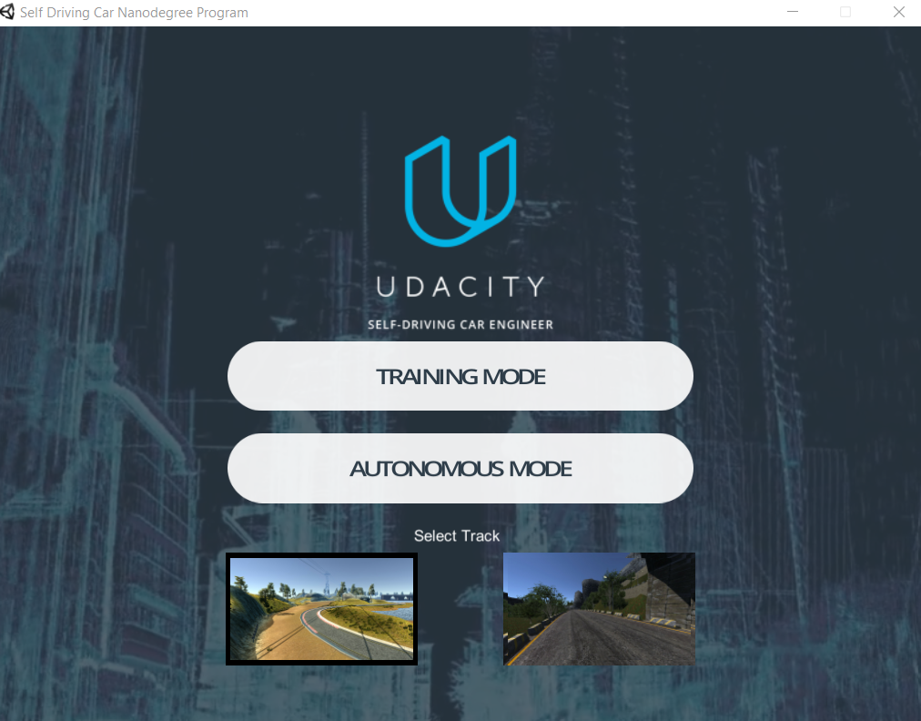
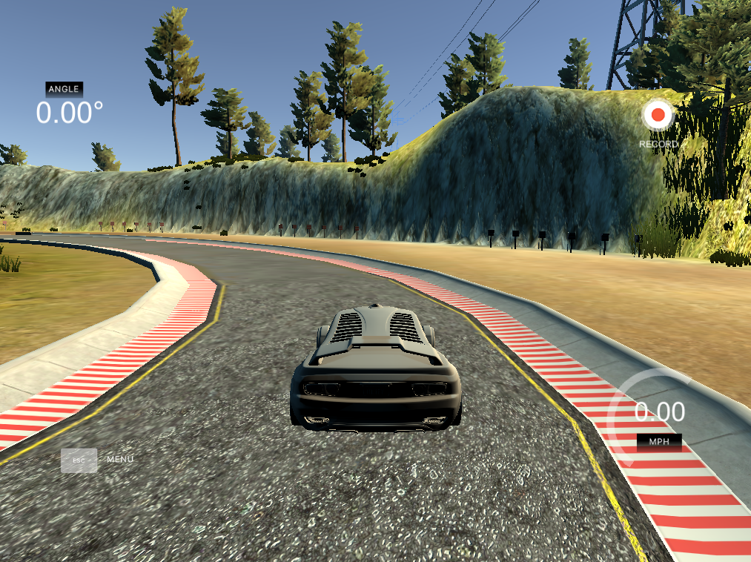
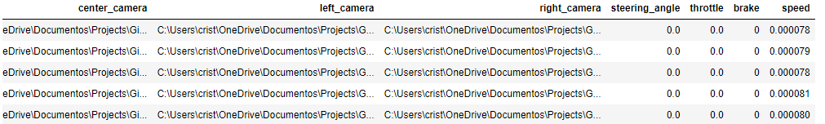
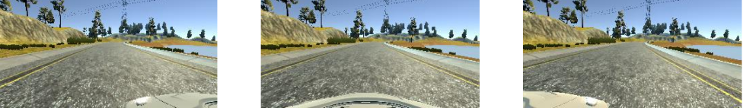
Dataset
The vehicle was driven manually on the first track for 4 laps in one direction and 4 more laps in the opposite direction. The data log is saved in a csv file and contains the path to the images, the steering angle, throttle, brake and speed.
Total images = (6563 rows)*(3 columns) = 19689
Notes:
For generating the data, I used the Udacity simulator. The vehicle was driven manually on the first track for 4 laps in one direction and 4 more laps on the opposite direction. The result of the data recording is a csv file that contains the path to the images (center, left and right), the steering angle, throttle, brake and speed.
There is a total of 6563 rows on the dataset and by multiplying this by 3, because we have the center, left and right cameras, we have a total of almost 20000 images.

Slide 4
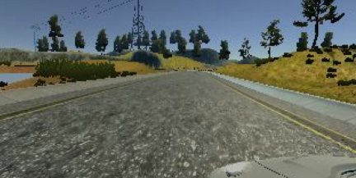
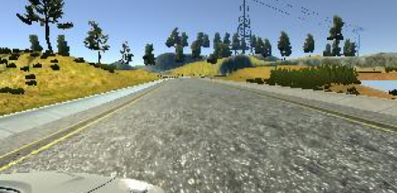
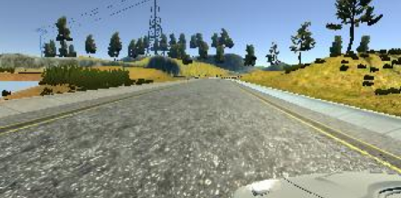
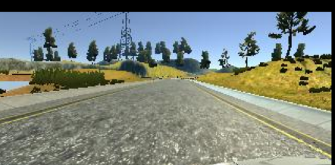
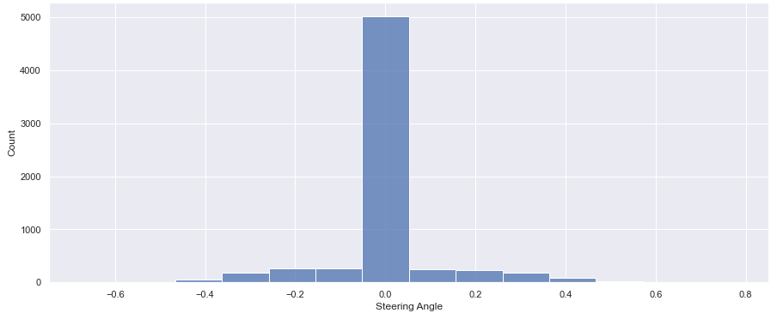
Data Augmentation
Brightness reduction
Horizontal Flipping
Translation
Left and Right Images
Notes:
Four different augmentation techniques were used to increase the number of images that the model would see during training, with this it can be also reduced the tendency of overfitting.
Modifying the brightness to simulate day and night conditions.
Shifting the images horizontally to simulate the effect of the car being at different positions on the road and shifting vertically to simulate the effect of driving up or down the slope.
Since the left and right turns in the training data are not even, image flipping was important for model generalization.
As we can see in the lower right plot, most of the steering angles were 0, which means going straight. To avoid this, the right and left camera images were included to simulate the effect of car wandering off to the side and recovering, for this we add an angle calibration of 0.25 for left images and -0.25 for right images.

Slide 5
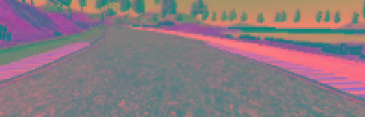
Data Preprocessing
Cropping
RGB to YUV
Resizing
Normalization
Notes:
After augmenting the images, data preprocessing was applied to format the images before using them by the model. The aim of preprocessing is to improve the quality of the image so that it can be analyzed in a better way. It is important to denote that image preprocessing is applied to all the data, with this I mean to training data, validation data and new data to create predictions.
It was cropped the bottom 25 and top 40 pixels from each image to remove the front of the car and most of the sky above the horizon from the images.
The images were converted from RGB to YUV type as it has more advantages in illumination changing and shape detection.
To be consistent with the NVIDIA model, all the images were resized to 66 height and 200 width.
Dividing by 255 the image pixel values to have just pixels values between 0 and 1.

Slide 6
Data Generator
As it is needed to generate thousands of new training instances from each original image, it is not possible to generate and store all these data on the disk. Therefore, keras generator were used to read original data from the log file, augment on the fly and use it to train the model producing new images at each batch.
Notes:
As it is needed to generate thousands of new training instances from each original image, it is not possible to generate and store all these data on the disk. Therefore, keras generator were used to read original data from the log file, augment on the fly and use it to train the model producing new images at each batch.

Slide 7
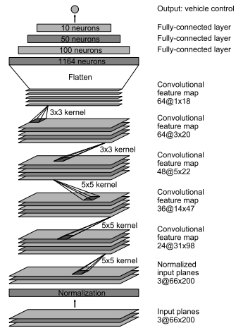
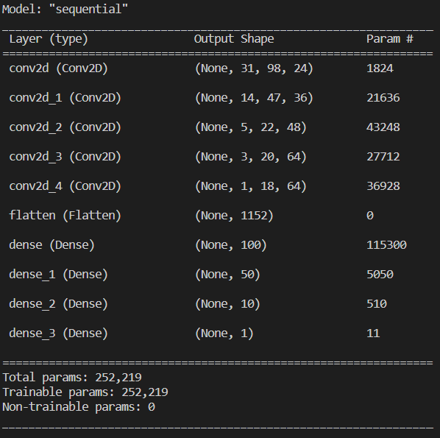
Model Proposal
https://images.nvidia.com/content/tegra/automotive/images/2016/solutions/pdf/end-to-end-dl-using-px.pdf
Notes:
The model architecture that I used was developed by NVIDIA in its DAVE-2 system for a real self driving cars with almost the same conditions of having three cameras at the front in the left, right and center.
- As we can see, the input image of the model is of shape 66 x 200
Then it has a series of convolutional layers with 5x5 kernels, and the respective depth of each layer is 24, 36 and 48 as going deeper into the network.
Then, there are two consecutive convolutional layers with 3x3 kernels, with both having a depth of 64.
The result is flattened into one dimensional array to enter into the fully connected layers
Finally, there is a series of fully connected layers, of gradually decreasing sizes: 1164, 200, 50 and 10.
The output layer is of size 1, since the prediction is just one variable, the steering angle.
As we can see in the bottom of the right image, this model has 252219 trainable parameters.

Slide 8
Model Parameters
Epochs | 5
Steps per Epoch | 20000
Batch Size | 64
Optimizer | Adam (0.0001)
Activation Function | ELU
The model was trained using a NVIDIA GeForce RTX 3050 GPU and the entire training took about 6 hours

Slide 9
Notes:
As we can see in the graph, as the epoch increases, the loss value decreases. Although at the beginning there is a big gap between training loss and validation loss, at the end, they become almost equal.

Slide 10
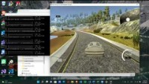

Slide 11
Questions?

Slide 12
THANKS
Do you have any questions?
crisdanrodvaz@gmail.com

